Slide 1


Marketing & Retail Analytics –
Capstone Project
Submitted By :
Jocelyne Gerda Sohkhlet
Lakshmi Prasanna Ganta
Sonia Dhanda

Slide 2

Agenda
Background
Objectives
Key Findings
Executive Summary
Recommendations
Appendix

Slide 3

Background
Olist is an E-commerce company that has faced losses recently. Their approach is to manage inventory efficiently and also to reduce unnecessary costs.
They want to analyze the purchase behavior of customers to identify the items likely to be purchases individually or in combination with other products.

Slide 4

Objectives :
To identify top products that contribute to revenue.
To reduce their losses by helping them cut down unnecessary inventory cost.
To identify individual product categories and combinations that can help with sales improvisation using Market Basket Analysis.

Slide 5
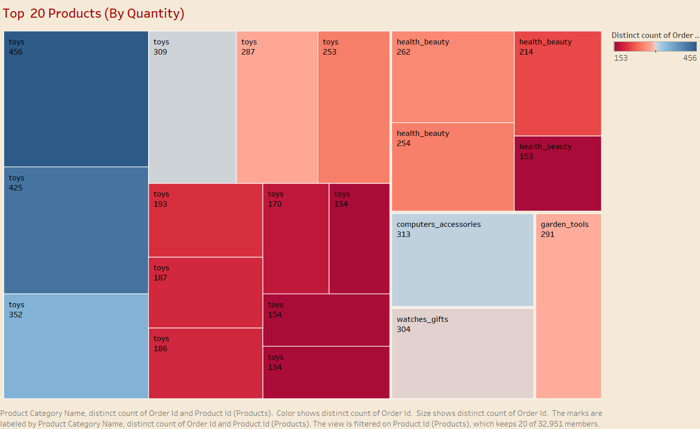
Top 20 Products By Quantity
The most ordered product belongs to “toys” category.

Slide 6
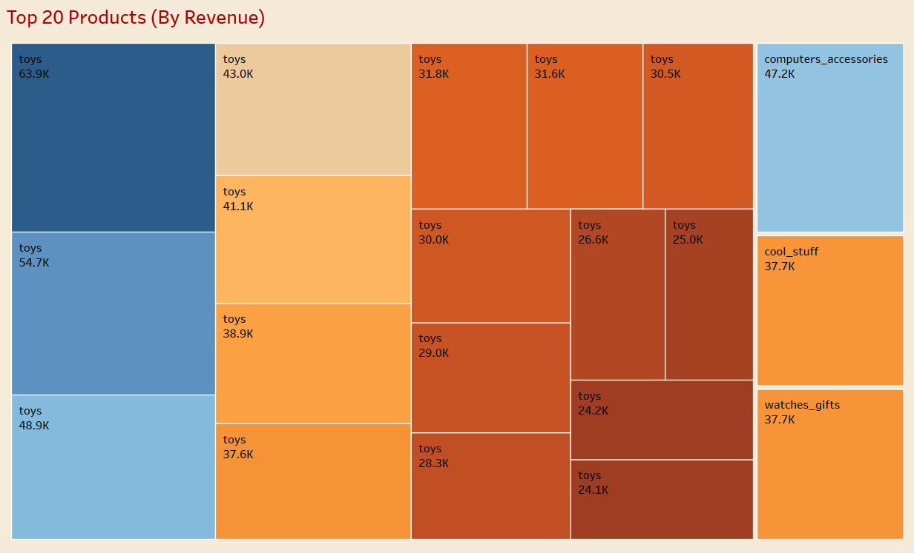
Top 20 Products By Revenue
Highest Revenue generation is 63.9K which belongs to “toys” category.

Slide 7

Insights:
The Product Category “toys” is the most ordered product as well as it contributes to most of the Revenue.
After toys, “health_beauty” is the most ordered Product category where as in terms of revenue it is “computers_accessories”. This implies that there are Product categories that are ordered less but contributes more revenue and people tend to buy branded or costly products if they like them or used to the product.
Along with toys , health_beauty & computers_accessories customers are also buying “watches_gifts” & “garden_tools” product category more frequently.

Slide 8
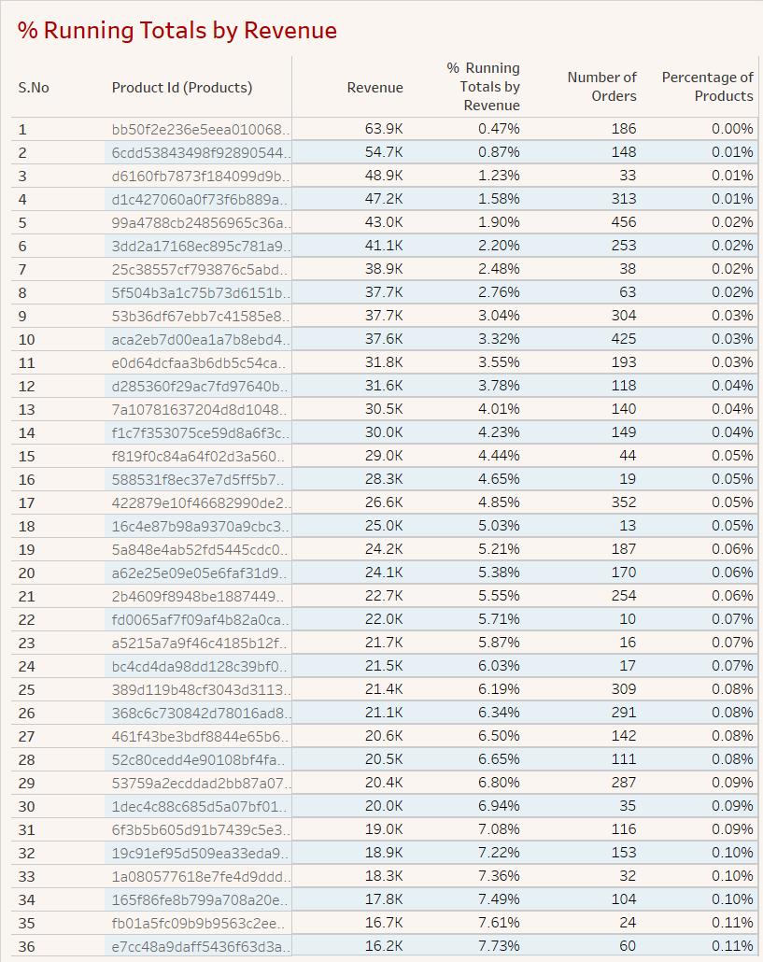
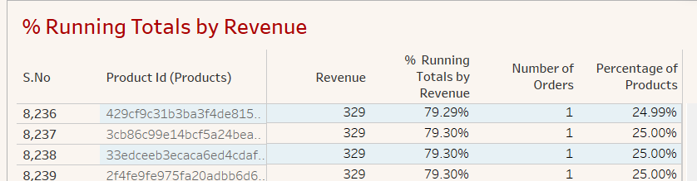
Percentage Running Totals By Revenue
The Top 3 products by Revenue despite being sold less contribute significantly to the net revenue.
The Top 20 products by Revenue contributes to around 5.4% of the Total Revenue.
About 25% of the Top Products by Revenue contributes to around 80% of the Total Revenue.

Slide 9
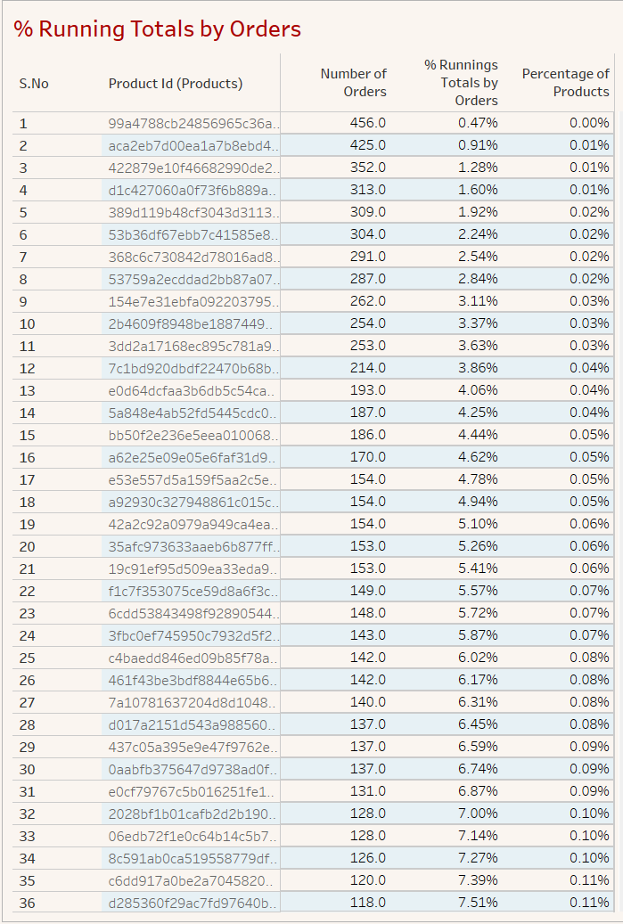
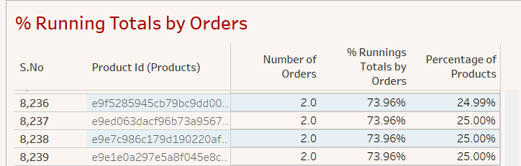
Percentage Running Totals By Order Quantity
Top 20 products by Order Quantity contribute to around 5.3% of the Total Orders.
About 25% of the Top Products by Order Quantity contributes to around 74% of the Total Orders.

Slide 10
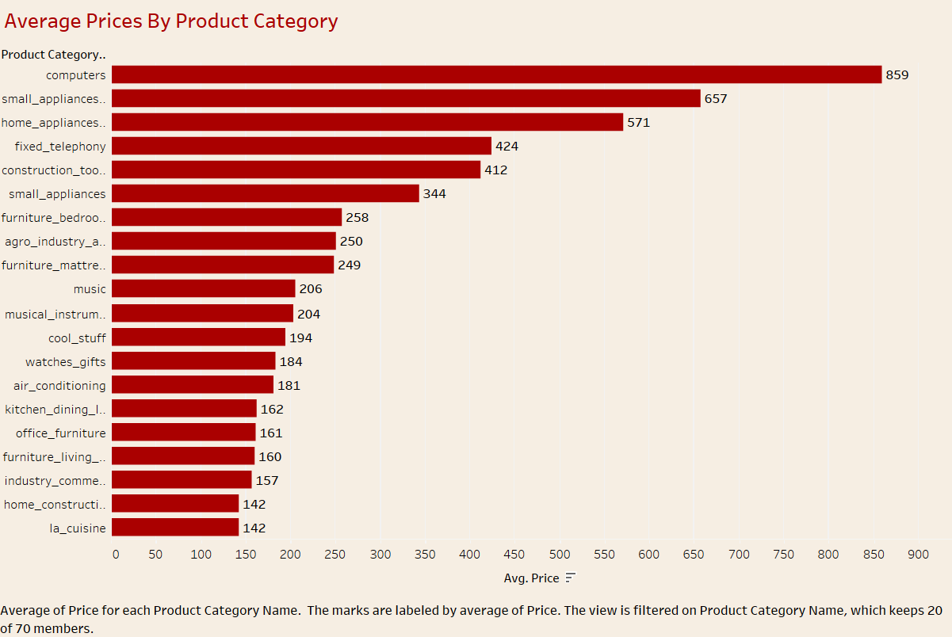
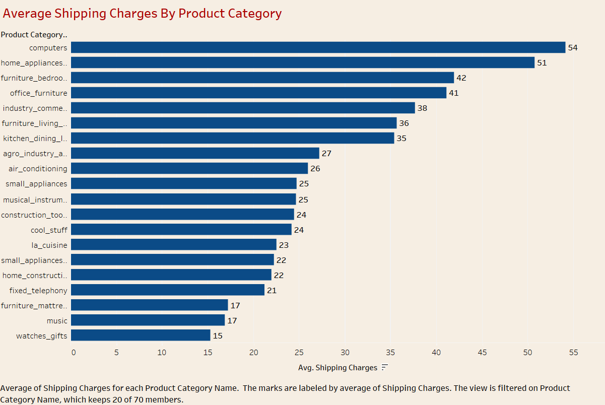
Average Prices & Shipping Charges By Product Category
The Average Price and Shipping charges associated with “Computers” are the highest but the number of orders are significantly low.
“Toys” is the highest selling product category and the prices & shipping charges associated with it are quite low.

Slide 11
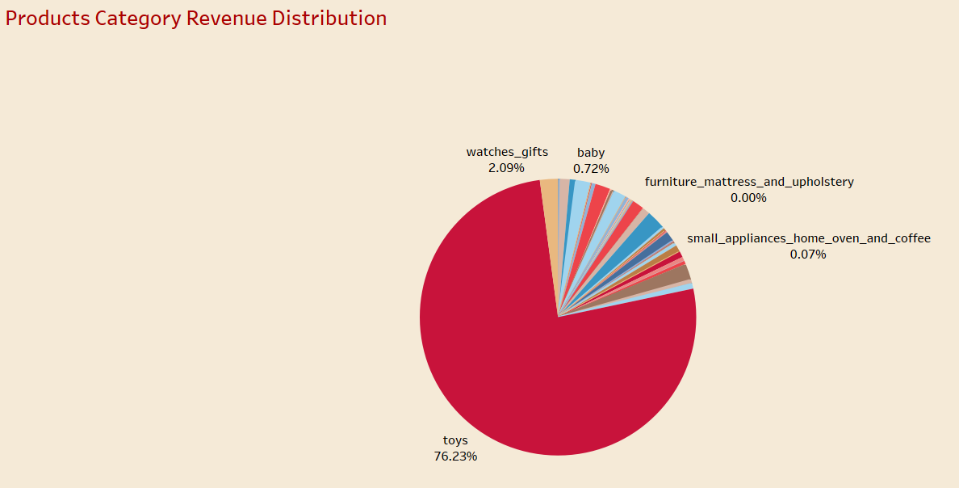
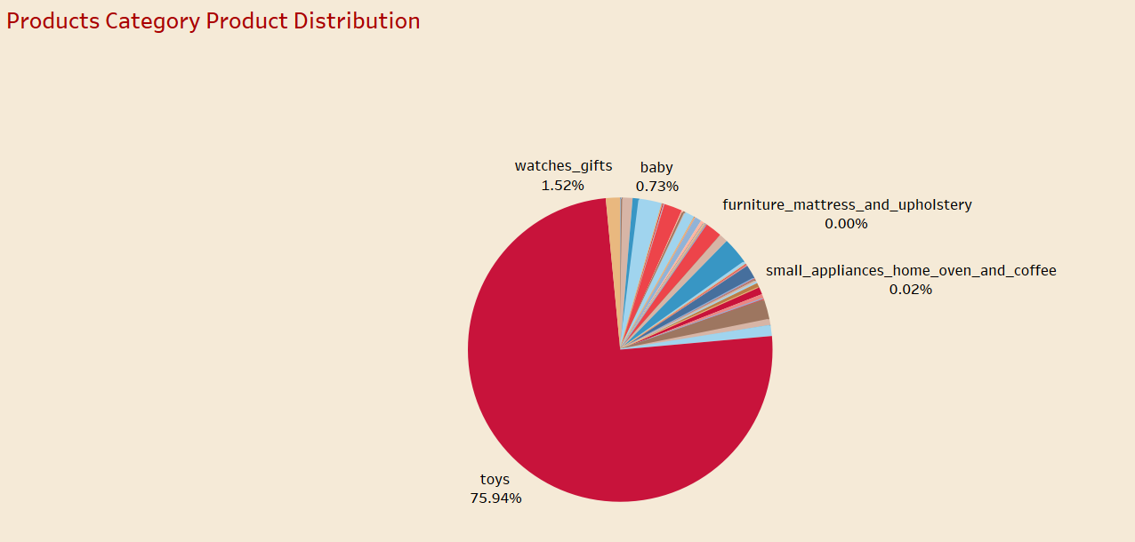
Product Category- Revenue & Product Distribution
“Toy” alone contribute to about 76% of the Total Revenue and Total Order Quantity.

Slide 12
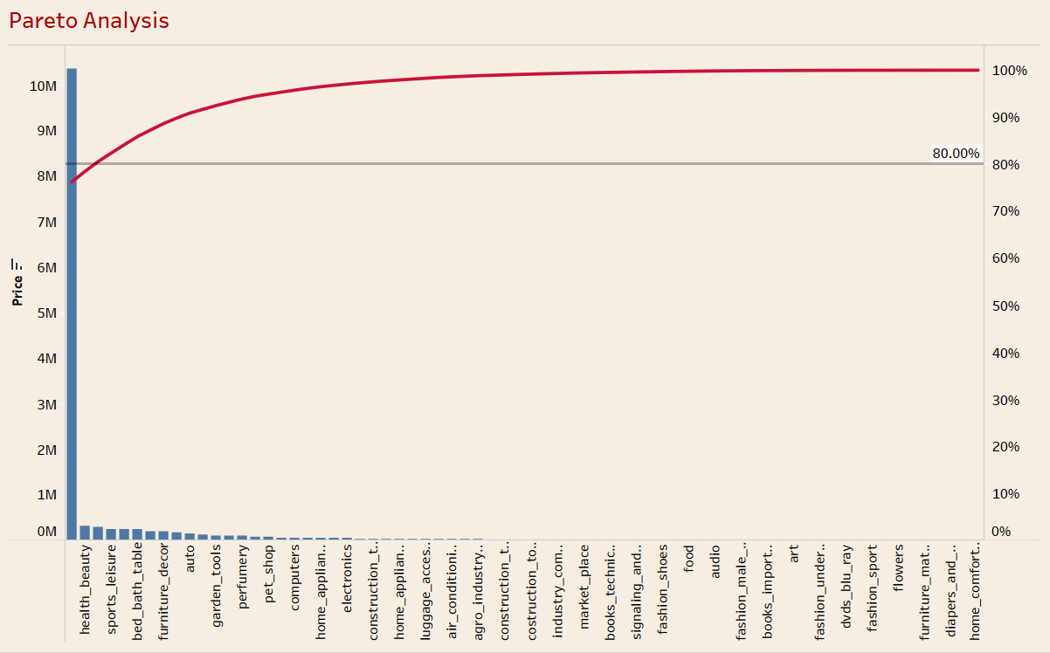
Pareto Analysis
80% of the Total Revenue is generated by “toys”, “health_beauty” & “watches_gifts” product categories.

Slide 13
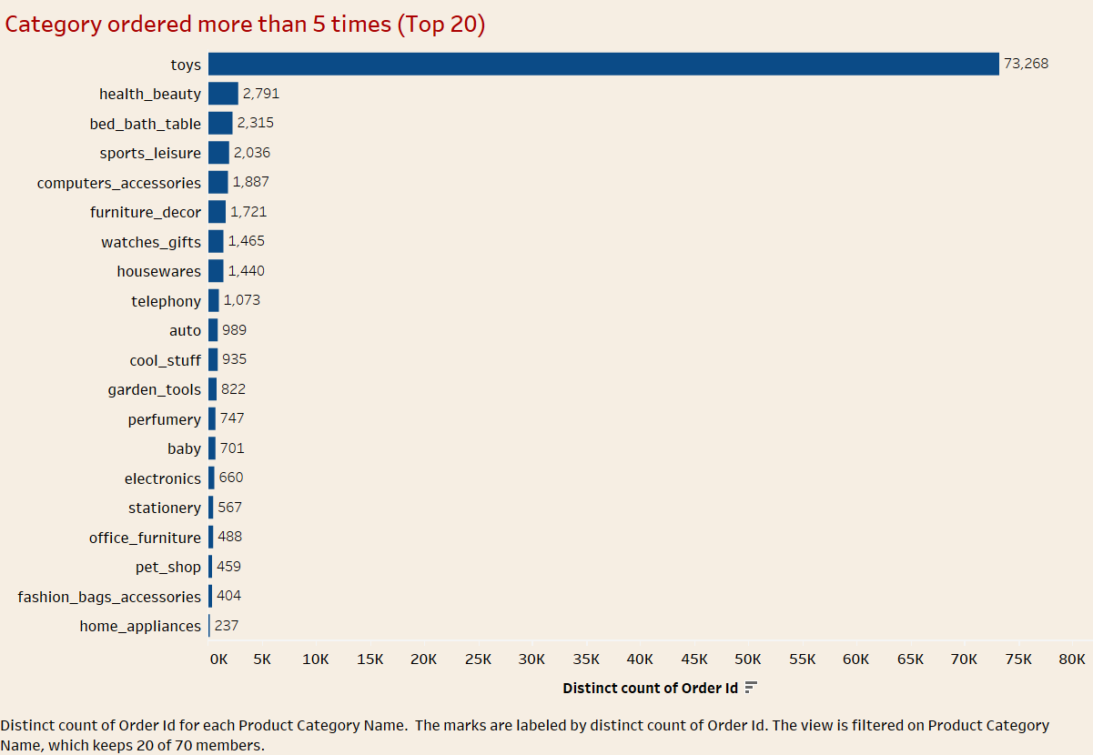
Category ordered more than 5 times (Top 20)

Slide 14
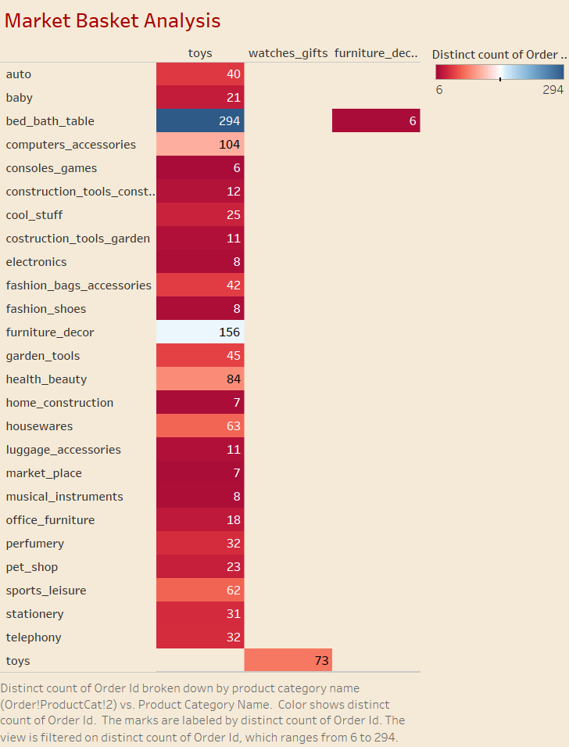
Market Basket Analysis
“health_beauty” is the 2nd most sold product category but it does not go along that well with “toys”
“bed_bath_table goes along well with ‘toys’
“furniture_decor &“computers_accessories” are two other product categories that are well linked with ‘toys’

Slide 15
Executive Summary:
The Product Category “toys” is the most ordered product as well as it contributes to most of the Revenue.
The Average Price and Shipping charges associated with “Computers” are the highest but the number of orders are significantly low.
80% of the Total Revenue is generated by “toys”, “health_beauty” & “watches_gifts” product categories.
“bed_bath_table , “furniture_decor &“computers_accessories are product category that goes well along with “toys”

Slide 16

Recommendations:
OList can consider reducing their stocks for ‘computers’ product category.
‘Toys’ should be held in stock by a good margin as they are contributing to a significant amount of revenue.
OList can come up with offers & discounts on categories like ‘bed bath table’ ,‘furniture decor’ and ‘computer accessories’ along with ‘toys’ to improvise their sales.
Many product categories as well as products are not much of a major contributor neither in terms of revenue nor in terms of number of orders so OList can consider removing these products or product categories or both to have an optimized inventory without affecting their sales much.

Slide 17

Appendix:
Data Source : Retail _dataset (OList)
We have assumed that shipping charges are not part of the revenue.
The complete analysis was carried out on data containing order status as “delivered”.
Outlier Treatment for the data was not done because in doing so we may end up losing certain pieces of information important for our analysis.
A Summary with a brief explanation of the assignment has been provided ahead for reference.

Slide 18
Summary:
We start off the things by data cleaning and understanding. In the data we have 5 sheets, viz, orders, order_items, customers, payments and products. For each sheet data was treated and read with the help of python libraries.
ORDERS - No duplicate values, Orders with order_status as ‘delivered’ were filtered, Missing values of timestamps were imputed as per the requirement, No outliers detected.
ORDER _ITEMS - No missing values, No duplicate values, Outlier treatment not done as may lead to data loss
CUSTOMERS - No missing values, Duplicate customer id’s were dropped, No outliers detected
PAYMENTS - No missing values, Duplicate order id’s were dropped, Outlier treatment not done as may lead to data loss
PRODUCTS - Missing values for product category name imputed with Mode; product weight with Median; product height, length, width with Mean; No duplicate values
»After the complete treatment the cleaned data was exported to Retail_dataset_cleaned excel file as the same sheet names.

Slide 19
Summary:
For the Market Basket Analysis we need to form a different dataset by a combination of products table and order_items table.
We do this with the help of the Python by forming an innerjoin between the two tables and fetching out the required columns. Then this newly generated table is exported as a new dataset: Market_Basket_Analysis.
For the visualization purpose we use Tableau for gathering insights about different products and product categories as well as for the Market Basket Analysis.
We found the Top 20 products both by Revenue and Order Quantity, Top 25%products and their contribution in the revenue as well as quantity separately, Average Price & Shipping Charges for different product categories, Total orders per product category, Pareto Analysis and Market Basket Analysis for both single category as well as combination of 2 categories

Slide 20
Thank You

